Slide 1
Self Driving Vehicle
Department of Computer Science University Of Balochistan
Group Members:
Syed Anwar (Roll No 46)
Bahadur Khan (Roll No 52)
Supervised By:
Dr. Abdul Basit

Slide 2
Introduction
Self-driving cars, also known as autonomous vehicles, are poised to reshape the way we commute and travel. These vehicles utilize advanced technologies, such as artificial intelligence and sensors, to navigate and make decisions without human intervention. With the potential to enhance safety, efficiency, and accessibility, self-driving cars represent a groundbreaking advancement in the transportation industry. As the technology continues to evolve, self-driving cars hold immense promise for a future of smarter, safer, and more convenient mobility.

Slide 3
Motivation
In a country like Pakistan, accidents are a major problem which must be solved using new technologies rather than traditional ways.
Pakistani’s peoples travel approximately 35 km/day, out of that 75% people using private vehicles. If the average speed is around 60 km/h then every person spends 30 minutes per day travelling. One crore plus people travel per day so people spend approximately 570 years in driving per day. This is too much time spent on just driving.
77.3% accidents caused because of Human error (2018). One-fourth of the Pakistani’s drivers use phones while driving which is dangerous for everybody (survey 2015).

Slide 4
Objectives
Building Car
Controlling Forward & Backward Movement
Handling Steering to turn left & right
Avoiding Obstacles using Sensor
Finding way to turn
Taking Weight around 75kg
Detecting Lanes
Integrating the system

Slide 5
Methodology
BTS Motor Driver
The BTS Motor Driver is used to control the gear DC motors, enabling the management of the forward and backward movement of the wheels.
L298n Motor Driver
The L298N motor driver is used to control the steering mechanism, enabling the vehicle to turn left and right.
Ultrasonic Sensor
Ultrasonic Sensor is used to detect obstacles in its path.

Slide 6
Methodology
Servo Motor
The servo motor positions and moves the ultrasonic sensor, allowing it to sweep from left to right in a 90-degree arc. This helps calculate distances when obstacles are detected.
Arduino
Arduino is used to transmit voltage and commands to the sensors, motor drivers, and motors.
Camera
The camera is used to capture frames, which are then passed to the Raspberry Pi for further processing.

Slide 7
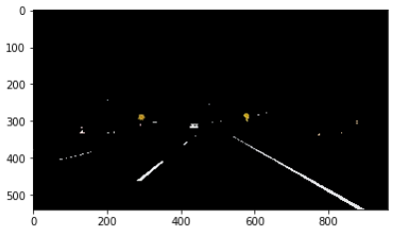
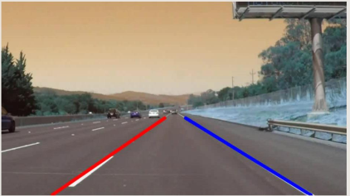
Methodology
Raspberry Pi
The Raspberry Pi is utilized for lane detection in the captured frames to make decisions. It establishes a serial communication with the Arduino to send commands, such as turning left or right, stopping, or moving forward.

Slide 8
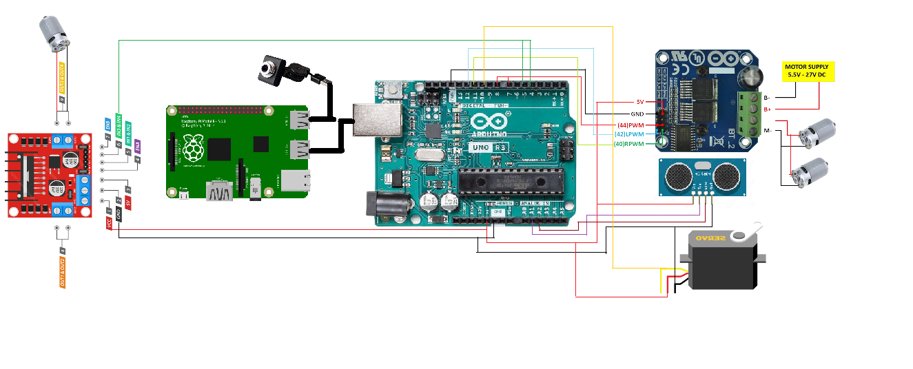
Integration Of Components

Slide 9
Decision-Making and Control
The Raspberry Pi detects lanes using image processing techniques such as RGB to HSV conversion, Gaussian blur, and Canny edge detection. It identifies lane lines using the HoughLinesP algorithm and calculates their slopes. Based on the count of left and right slopes, it commands the Arduino to turn left or right to stay within the lanes. The Arduino also detects obstacles using ultrasonic sensor and commands the motor drivers to avoid them.

Slide 10
Challenges
Voltage Dropping
Load Taking
Distance Calculating
Arduino Pins Limitations
Raspberry Pi Processing Limitations

Slide 11
Conclusion
Our implementation of sensors, cameras, and advanced computing systems has successfully achieved our goals in controlling a large car with enhanced capabilities. By integrating these technologies, we have effectively addressed challenges related to maneuvering a larger vehicle. The use of ultrasonic sensors enables obstacle detection, enhancing safety and reducing the risk of accidents. The integration of a camera and Raspberry Pi allows for accurate lane detection and navigation, minimizing lane departures. Overall, our solution provides an effective and versatile means of controlling a large car, even in challenging driving conditions, with a weight capacity of up to 75kg.

Slide 12
Thank You

